Slide 1
E-Commerce database management system
Members:
Chandan Kumar (2019ucs0094)
Anshul Sharma (2019ucs0074)
Abhishek Maurya (2019uee0134)
Abhay Yadav (2019uee0110)
Sachin Naik (2019ucs0091)
Anant Kumar (2019uce0059)
Saurabh Kumar Verma (2019uch0033)
Balwant Yadav (2019uch0009)

Slide 2
Enterprise-Description
Customer
A unique identification number is given to every customer .
Every customer has name , gender , customer address , customer phone number .
And every customer has different id types which will describe about id discount .
Every customer has last purchase details.
Seller
A unique identification number is given to seller.
Every seller has name , address , contact number , gmail id .
Each seller must have one and unique gmail_id
Product
Every product has unique identification number and each product have different product number .
Every product belong to some brand name.
For every product there will be quantity , cost, discount and ratings properties should be listed.
Cart
For every customer a unique identification cart id should be given.
Every cart contains the total number of products and amount of the cart items.
Cart Items:
Every cart items will contain the user chosen products along with their quantity and date of addition.
Payment:
For every payment done by the customer a unique payment id should be given.
Payment date and time should be listed at which time the payment will be done
Total amount & payment mode should be also contained.

Slide 3
Entities :
Customer, Payment, Cart, Cart-items, Product, Seller
Relationship :
Entity 1 | Entity 2 | Relationship
Customer | Payment | Made
Payment | Cart | Done for
Cart | Cart Items | Contains
Product | Cart items | Added to
Customer | Cart | has
Seller | Product | Sells

Slide 4
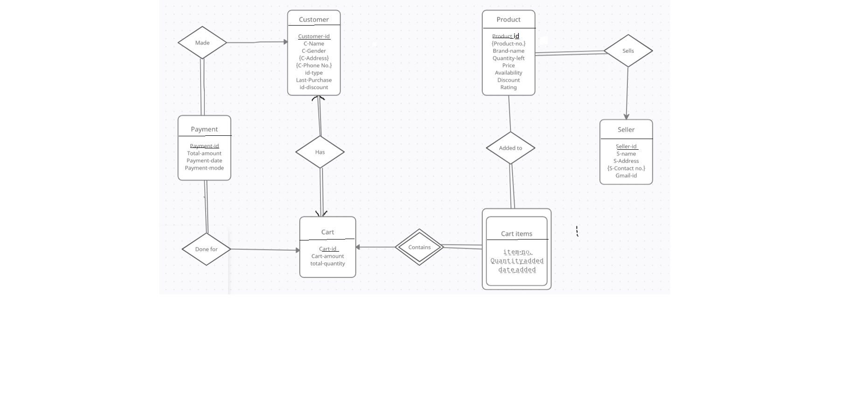
E-R Diagram

Slide 5
Reduction to relational schema
Payment (payment_id, total_amount, payment_date , payment_mode , customer_id , cart_id)
Customer (customer_id, customer_name, gender, id_type, last_purchase, id_discount, cart_id)
Cart (cart_id, cart_amount, total_amount)
Cart_item (item_id, quantity_added, date_added, cart_id)
Product (product_id, brand_name, quantity_left, price,availability, discount, rating, seller_id)
Seller (seller_id, seller_name, gmail_id)
Seller_addr(seller_id, seller_address)
Customer_addr (customer_id, customer_address)
Customer_phone (customer_id, customer_phone_number)
Product_item_number (product_id, product_number)
Added_to (product_id, item_id, quantity_added, date_added, cart_id)
Seller_phone (seller_id, seller_phone_number)

Slide 6
Payment (payment_id, total_amount, payment_date , payment_mode , customer_id ,
cart_id)
Non trivial Functional dependencies:
F = {payment_id→ total_amount,
payment_id→ payment_date,
payment_id→ payment_mode,
payment_id→ customer_id,
customer_id→ cart_id,
Cart_id→customer_id }

Slide 7
Closure of F :
Taking, payment_id=A, total_amount=B, payment_date=C, payment_mode=D,
customer_id=E, cart_id=F.
Closure of F (F⁺ ) : {A→B, A→C, A→D, A→E, E→F, F→E,A→F, A→BC, A→CD,
A→DE, A→EF, A→BD, A→BE, A→BF, A→CE, A→CF, A→BCD,
A→CDF, A→BCDE, A→CDEF, A→BCDEF, A→ABC, A→ACD,
A→ACDE, A→ABCDE, A→ACDEF, A→ABCDEF, A→ABCD,
E→EF, F→EF……}
Closure of attributes :(Payment_id ⁺) → {payment_id, total_amount, payment_date,
payment_mode, customer_id, cart_id}
(customer_id⁺) → {customer_id , cart_id }
(cart_id⁺) → {cart_id , customer_id}

Slide 8
No extraneous attributes found , so canonical cover of functional dependencies is same as closure of functional dependencies
Candidate key : payment_id
Prime attributes : payment_id
Non prime attributes : total_amount, payment_date , payment_mode , customer_id , cart_id
Normal Form:
Here all attributes are atomic, so it is in 1st Normal form.
Here all non prime attributes are fully functional dependent on primary key. So it is in 2nd Normal form.
non-prime attributes are transitively dependent on primary key so it is not in 3rd NF.
r1(payment_id, total_amount, payment_date , payment_mode , customer_id)
r2(customer_id , cart_id)
Decomposed relation is in BCNF.

Slide 9
Customer (customer_id, customer_name, gender, id_type, last_purchase, id_discount, cart_id)
Non trivial Functional dependencies :
F={ customer_id→customer_name,
customer_id→gender,
customer_id→id_type,
customer_id→last_purchase,
customer_id→cart_id,
id_type→id_discount,
cart_id→customer_id}

Slide 10
Closure of F :
Taking, customer_id=A, customer_name=B, gender=C, id_type=D, last_purchase=E,
id_discount=F, cart_id=G.
Closure of F (F⁺) :
{A→B, A→C, A→D, A→E, A→F, A→G, D→F, G→A, G→B, G→C, G→D, G→E, G→F, A→BC, A→CD, A→DE, A→EF, A→FG, A→BD, A→BF,
A→BE, A→BCD, A→BCDE, A→BCDEF, A→CDE, A→CDEF, A→AB, A→AC, A→AD, A→AE, A→AF, A→ABC, A→ABD, A→ACD,
A→ABCD, A→ACDE, A→DEF, A→ABCDEFG, G→BC, G→CD, G→DE, G→EF, G→FA, G→BD, G→BF, G→BE, G→BCD, G→BCDE,
G→BCDEF, G→CDE, G→CDEF, G→GB,G→AC, G→AD, G→AE, G→AF, G→ABC, G→ABD, G→ACD, G→ABCD, G→ACDE, G→DEF,
G→ABCDEFG, AG→BC, AG→CD, AG→DE, AG→EF, AG→FA, AG→BD, AG→BF, AG→BE, AG→BCD, AG→BCDE, AG→BCDEF,
AG→CDE, AG→CDEF, AG→GB, AG→AC, GA→AD, AG→AE, AG→AF, AG→ABC, AG→ABD, AG→ACD, AG→ABCD, AG→ACDE,
AG→DEF, AG→ABCDEFG,......}
Closure of attributes :
(customer_id⁺) → {customer_id, customer_name, gender ,id_type, last_purchase, id_discount, cart_id}
(cart_id⁺) → {customer_id, cart_id , customer_name , gender ,id_type, last_purchase , id_discount }
(id_type⁺) → { id_type , id_discount}

Slide 11
Canonical cover of functional dependencies :
{A→B, A→C, A→D, A→E, A→F, A→G, D→F, G→A, G→B, G→C, G→D, G→E, G→F, A→BC, A→CD, A→DE,
A→EF, A→FG, A→BD, A→BF, A→BE, A→BCD, A→BCDE, A→BCDEF, A→CDE, A→CDEF, A→AB, A→AC,
A→AD, A→AE, A→AF, A→ABC, A→ABD, A→ACD, A→ABCD, A→ACDE, A→DEF, A→ABCDEFG, G→BC,
G→CD, G→DE, G→EF, G→FA, G→BD, G→BF, G→BE, G→BCD, G→BCDE, G→BCDEF, G→CDE, G→CDEF,
G→GB, G→AC, G→AD, G→AE, G→AF, G→ABC, G→ABD, G→ACD, G→ABCD, G→ACDE, G→DEF,
G→ABCDEFG,......}
Candidate key: customer_id , cart_id
Prime attributes : customer_id, cart_id
Non-Prime attributes: customer_name, gender, id_type, last_purchase, id_discount
Normal Form:
Here all attributes are atomic, so it is in 1st Normal form.
Here all non prime attributes are fully functional dependent on primary key. So it is in 2nd Normal form.
non-prime attributes are transitively dependent on primary key so it is not in 3rd NF.
r1(customer_id, customer_name, gender, id_type, last_purchase, cart_id)
r2(id_type, id_discount)
r3(customer_id, cart_id)
Now, all relation also in BCNF.

Slide 12
Cart (cart_id, cart_amount, total_quantity)
Non trivial Functional dependencies:
F= {cart_id→cart_amount ,
cart_id→total_quantity}
Closure of F :
Taking, cart_id=A, cart-amount=B, total_quantity=C
Closure of F (F⁺ ) : {A→B, A→C, A→BC, A→AB, A→AC, A→ABC}
Closure of Attributes: (cart_id⁺) → {cart_id , cart_amount , total_quantity}

Slide 13
No extraneous attributes found , so canonical cover of functional dependencies is same as closure of functional dependencies .
Candidate key : cart_id
Prime attributes : cart_id
Non prime attributes : cart_amount, total_quantity
Normal Form:
Here all attributes are atomic, so it is in 1st Normal form..
Here all non prime attributes are fully functional dependent on primary key. So it is in 2nd Normal form.
No non-prime attributes are transitively dependent on primary key so it is in 3rd NF.
It is in BCNF form.

Slide 14
Product (product_id, brand_name, quantity_left, price,availability, discount, rating, seller_id)
Non trivial Functional dependencies:
F = {product_id→ brand_name,
product_id→ quantity_left,
product_id→ price,
product_id→ discount,
product_id→rating,
product_id→ seller_id,
quatity_left→availability}

Slide 15
Closure of F :
Taking, product_id=A, brand_name=B, quantity_left=C, price=D, availability=E, discount=F,
rating=G, seller_id=H.
Closure of F (F⁺ ) :
{A→B, A→C, A→D, A→F, A→G, A→H, C→E, A→E,A→BC, A→CD, A→DE, A→EF, A→FG, A→BD, A→BF, A→BE, A→BCD,
A→BCDE, A→BCDEF, A→CDE, A→CDEF, A→AB, A→AC, A→AD, A→AE, A→AF, A→ABC, A→ABD, A→ACD, A→ABCD, A→ACDE,
A→DEF, A→ABCDEFG,A→BCH, A→CDH, A→DEH, A→EFH, A→FGH, A→BDH, A→BFH, A→BEH, A→BCDH, A→BCDEH,
A→BCDEFH, A→AD, A→AE,A→ABCH, A→ABDH, A→ACDH, A→ABCDH, A→ACDEH, A→DEFH, A→ABCDEFGH, C→CE,
AC→BCDE, AC→BCDEF, AC→CDE, AC→CDEF, AC→AB, AC→AC, AC→AD, AC→AE, AC→AF, AC→ABC, AC→ABD, AC→ACD,
AC→ABCD, AC→ACDE, AC→DEF, AC→ABCDEFG,AC→BCH, AC→CDH, AC→DEH, AC→EFH, AC→FGH, AC→BDH, AC→BFH,
AC→BEH, AC→BCDH, AC→BCDEH,....}
Closure of attributes:
(product_id⁺) → { product_id ,brand_name , quantity_left , price , availability , discount , rating , seller_id}
(quantity_left⁺) → { quantity_left , availability}

Slide 16
Canonical cover of functional dependencies
{A→B, A→C, A→D, A→F, A→G, A→H, C→E,A→E, A→BC, A→CD, A→DE, A→EF, A→FG, A→BD, A→BF, A→BE, A→BCD,
A→BCDE, A→BCDEF, A→CDE, A→CDEF, A→AB, A→AC, A→AD, A→AE, A→AF, A→ABC, A→ABD, A→ACD, A→ABCD,
A→ACDE, A→DEF, A→ABCDEFG,A→BCH, A→CDH, A→DEH, A→EFH, A→FGH, A→BDH, A→BFH, A→BEH, A→BCDH,
A→BCDEH, A→BCDEFH, A→AD, A→AE,A→ABCH, A→ABDH, A→ACDH, A→ABCDH, A→ACDEH, A→DEFH,
A→ABCDEFGH, C→CE, ....}
Candidate key : product_id
Prime attributes : product_id
Non prime attributes : brand_name, quantity_left, price, availability, discount, rating, seller_id
Normal Form:
Here all attributes are atomic, so it is in 1st Normal form.
Here all non prime attributes are fully functional dependent on primary key. So it is in 2nd Normal form.
non-prime attributes are transitively dependent on primary key so it is not in 3rd NF.
r1(product_id, brand_name, quantity_left, price, discount, rating, seller_id)
r2(quantity_left, availability)
Decomposed relation is in BCNF.

Slide 17
Seller (seller_id, seller_name, gmail_id)
Non trivial Functional dependencies:
F={seller_id→seller_name,
Seller_id→gmail_id,
gmail_id→Seller_id,
gmail_id→Seller_name}

Slide 18
Closure of F :
Taking, seller_id=A, seller_name=B, gmail_id=C
Closure of F (F⁺) :
{A→B, A→C,C→A, C→B, C→AB, C→ABC, A→BC, A→AB, A→AC, A→ABC }
Closure of attributes :
(seller_id⁺) → { seller_id , seller_name , gmail_id}
(gmail_id⁺) → { seller_id , seller_name , gmail_id}

Slide 19
No extraneous attributes found , so canonical cover of functional dependencies is same as closure of functional dependencies
Candidate key : seller_id, gmail_id
Prime attributes : seller_id, gmail_id
Non prime attributes : seller_name
Normal Form:
Here all attributes are atomic, so it is in 1st Normal form.
Here all non prime attributes are fully functional dependent on primary key. So it is in 2nd Normal form.
No non-prime attributes are transitively dependent on primary key so it is in 3rd NF.
It is in BCNF form.

Slide 20
THANK YOU

